Slide 1
Lecture 2: Analysis of Algorithms
“For me, great algorithms are the poetry of computation. Just like verse, they can be terse, allusive, dense, and even mysterious. But once unlocked, they cast a brilliant new light on some aspect of computing.” - Francis Sullivan

Slide 2


A running example: Insertion sort
Input: An array $A[1…n]$ of elements
Output: Array $A[1…n]$ of elements in sorted order (ascending)
Insertion-Sort($A$):
for $j ← 2$ to $n$ do
$key←A[j]$
$i←j−1$
while $i≥1$ and $A[i]>key$ do
$A[i+1]←A[i]$
$i←i−1$
$A\left[i+1\right]←key$
sorted
key
unsorted
Each iteration of the outer loop finds the right position to put “key”

Slide 3
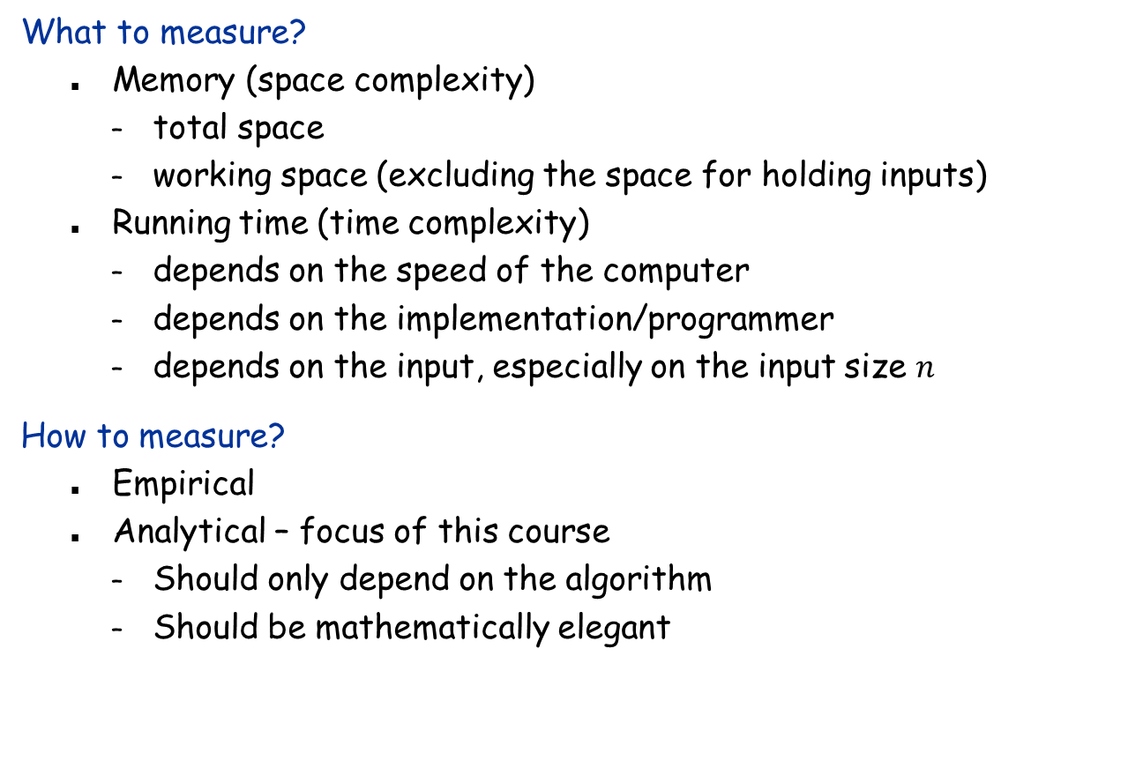
How to evaluate an algorithm (compare two algorithms)?
What to measure?
Memory (space complexity)
total space
working space (excluding the space for holding inputs)
Running time (time complexity)
depends on the speed of the computer
depends on the implementation/programmer
depends on the input, especially on the input size $n$
How to measure?
Empirical
Analytical – focus of this course
Should only depend on the algorithm
Should be mathematically elegant

Slide 4
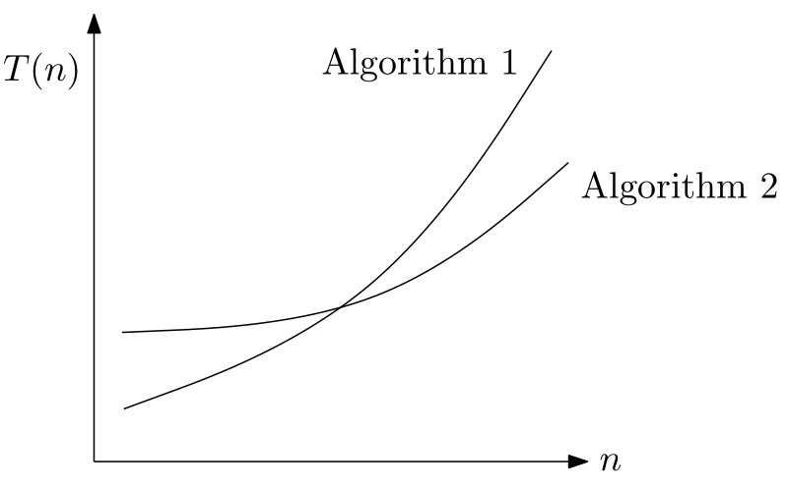
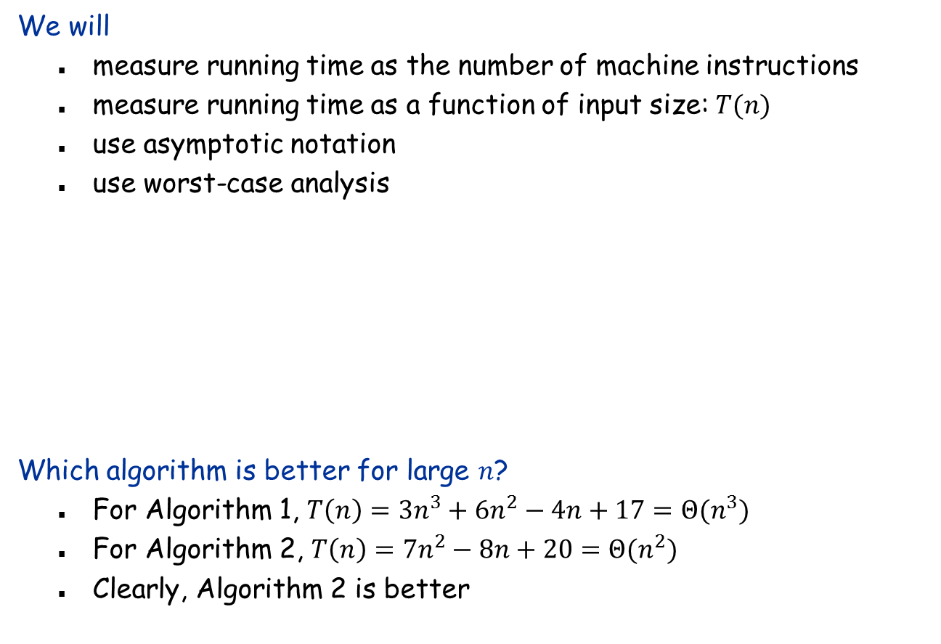
Measuring Running Time
We will
measure running time as the number of machine instructions
measure running time as a function of input size: $T(n)$
use asymptotic notation
use worst-case analysis
Which algorithm is better for large $n$?
For Algorithm 1, $T\left(n\right)=3n^{3}+6n^{2}−4n+17=Θ(n^{3})$
For Algorithm 2, $T\left(n\right)=7n^{2}−8n+20=Θ(n^{2})$
Clearly, Algorithm 2 is better

Slide 5
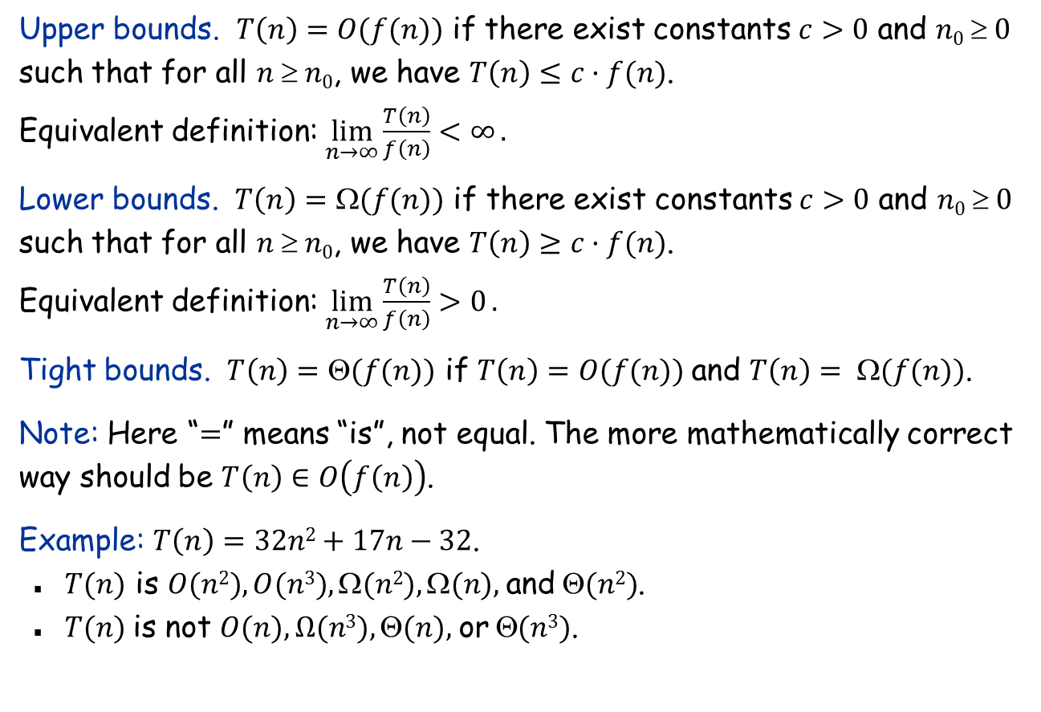
Asymptotic Notation
Upper bounds. $T\left(n\right)=O(f(n))$ if there exist constants $c>0$ and $n0  0$ such that for all $n  n0$, we have $T\left(n\right)≤c·f(n)$.
Equivalent definition: $\lim_{n→∞}{\frac{T\left(n\right)}{f\left(n\right)}<∞}.$
Lower bounds. $T\left(n\right)=Ω(f(n))$ if there exist constants $c>0$ and $n0  0$ such that for all $n  n0$, we have $T\left(n\right)≥c·f(n)$.
Equivalent definition: $\lim_{n→∞}{\frac{T\left(n\right)}{f\left(n\right)}>0}.$
Tight bounds. $T\left(n\right)=Θ(f(n))$ if $T\left(n\right)=O(f(n))$and $T\left(n\right)= Ω(f(n))$.
Note: Here “$=$” means “is”, not equal. The more mathematically correct way should be $T\left(n\right)∈O\left(f\left(n\right)\right)$.
Example: $T\left(n\right)=32n2+17n−32$.
$T(n)$ is $O(n2), O(n3), (n2), (n),$and$(n2)$.
$T(n)$is not $O(n), Ω(n3), (n),$or$(n3)$.

Slide 6
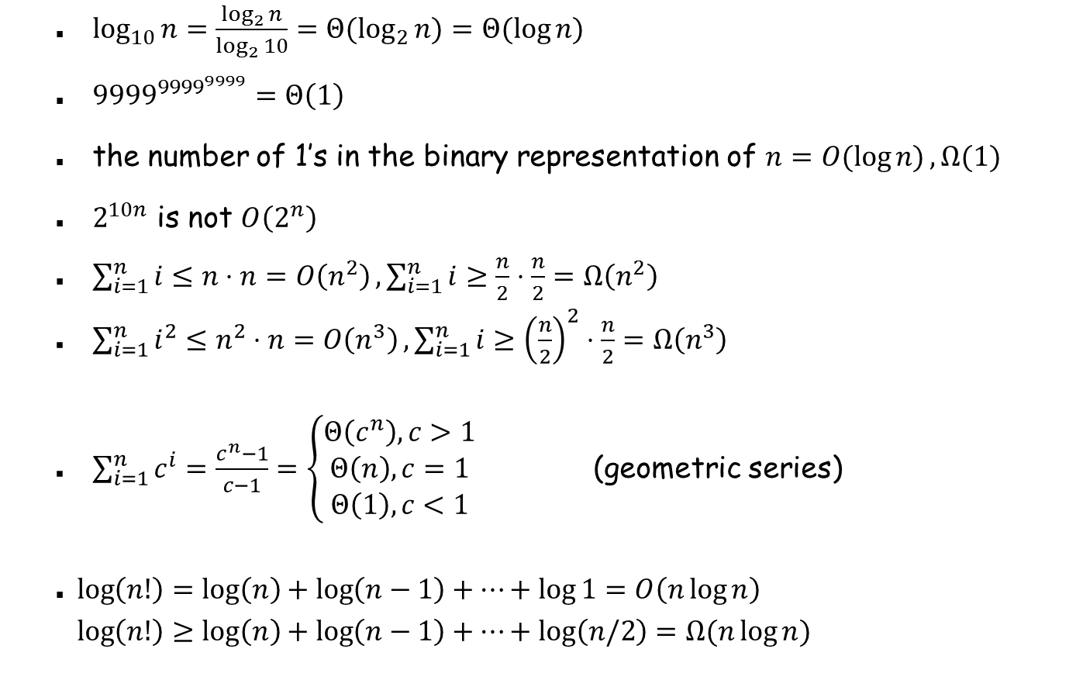
Asymptotic notation: More examples
$\log_{10}{n=\frac{\log_{2}{n}}{\log_{2}{10}}}=Θ(\log_{2}{n)=Θ(\log{n)}}$
${9999}^{{9999}^{9999}}=Θ\left(1\right)$
the number of 1’s in the binary representation of $n=O(\log{n)},Ω(1)$
$2^{10n}$ is not $O\left(2^{n}\right)$
$\sum_{i=1}^{n}{i≤n⋅n=O\left(n^{2}\right)},\sum_{i=1}^{n}{i≥\frac{n}{2}⋅\frac{n}{2}=Ω\left(n^{2}\right)}$
$\sum_{i=1}^{n}{i^{2}≤n^{2}⋅n=O\left(n^{3}\right)},\sum_{i=1}^{n}{i≥{\left(\frac{n}{2}\right)}^{2}⋅\frac{n}{2}=Ω\left(n^{3}\right)}$
$\sum_{i=1}^{n}{c^{i}=\frac{c^{n}−1}{c−1}=\left\{\begin{aligned}Θ\left(c^{n}\right), c>1 \\ Θ\left(n\right), c=1 \\ Θ\left(1\right), c<1\end{aligned}\right.}$ (geometric series)
$\log\left(n!\right)=\log\left(n\right)+\log\left(n−1\right)+…+\log{1=O\left(n\log{n}\right)}$ $\log\left(n!\right)≥\log\left(n\right)+\log\left(n−1\right)+…+log\left(n/2\right)=Ω(n\log{n)}$

Slide 7

Asymptotic notation: More examples
$\log^{10}{n}=O\left(n^{0.1}\right), n^{100}=O\left(2^{n}\right), loglog n=O\left(log n\right)$
$\sum_{i=1}^{n}{\frac{1}{i}=Θ\left(log n\right)}$ (harmonic series, derivation on board)
$n\log{n=}O\left(\frac{n^{2}}{\log{n}}\right)$
$n^{0.1}+\log^{10}{n=Θ\left(n^{0.1}\right)}$
$f\left(n\right)+g\left(n\right)=Θ\left(\max\left(f\left(n\right),g\left(n\right)\right)\right)$

Slide 8


Best-Case Analysis
Best case: An instance for a given size $n$ that results in the fastest possible running time.
Example (insertion sort): Input already sorted
for $j ← 2$ to $n$ do
$key←A[j]$
$i←j−1$
while $i≥1$ and $A[i]>key$ do
$A[i+1]←A[i]$
$i←i−1$
$A\left[i+1\right]←key$
sorted
key
unsorted
“key” is compared to only the element right before it, so $T\left(n\right)=Θ(n)$.

Slide 9


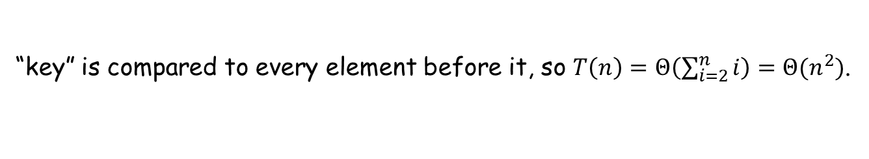
Worst-Case Analysis
Worst case: An instance for a given size $n$that results in the slowest possible running time.
Example (insertion sort): Input inversely sorted
for $j ← 2$ to $n$ do
$key←A[j]$
$i←j−1$
while $i≥1$ and $A[i]>key$ do
$A[i+1]←A[i]$
$i←i−1$
$A\left[i+1\right]←key$
sorted
key
unsorted
“key” is compared to every element before it, so $T\left(n\right)=Θ\left(\sum_{i=2}^{n}{i}\right)=Θ(n^{2})$.

Slide 10
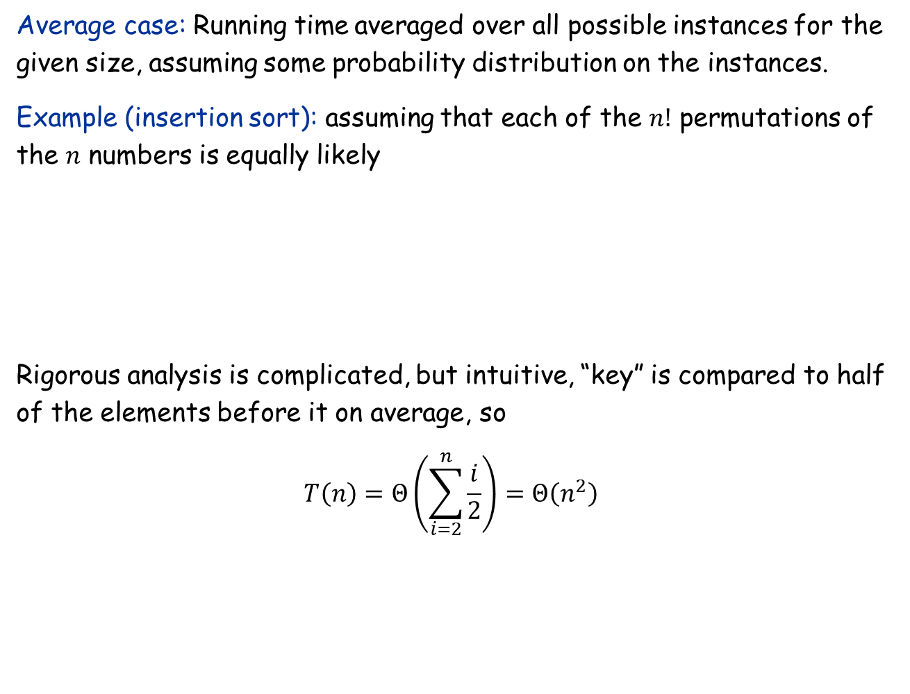
Average-Case Analysis
Average case: Running time averaged over all possible instances for the given size, assuming some probability distribution on the instances.
Example (insertion sort): assuming that each of the $n!$ permutations of the $n$ numbers is equally likely
Rigorous analysis is complicated, but intuitive, “key” is compared to half of the elements before it on average, so
$$T\left(n\right)=Θ\left(\sum_{i=2}^{n}{\frac{i}{2}}\right)=Θ\left(n^{2}\right)$$
sorted
key
unsorted

Slide 11
Three Kinds of Analyses
Best case: Clearly useless
Worst case: Commonly used, will also be used in this course
Gives a running time guarantee no matter what the input is
Fair comparison among different algorithms
Not perfect: For some problems, the worst-case input never occurs in real life; some algorithms with bad worst-case running time actually work very well in practice (e.g. the simplex algorithm for linear programming)
Worst-case analysis will be the default
Average case: Used sometimes
Need to assume some distribution: real-world inputs are seldom uniformly random!
Analysis is complicated
Will see one example later

Slide 12
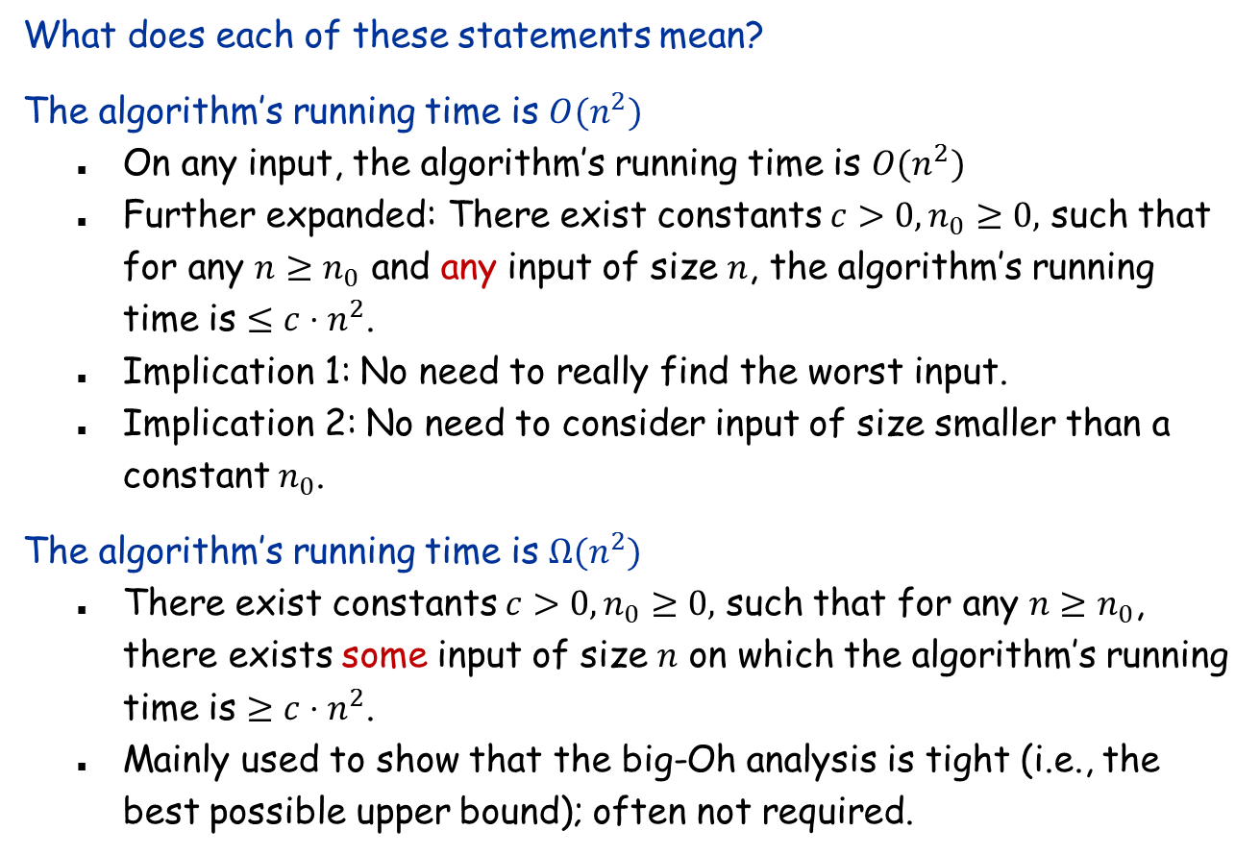
More on Worst-Case Analysis
What does each of these statements mean?
The algorithm’s running time is $O(n^{2})$
On any input, the algorithm’s running time is $O(n^{2})$
Further expanded: There exist constants $c>0,n_{0}≥0,$ such that for any $n≥n_{0}$ and any input of size $n$, the algorithm’s running time is $≤c⋅n^{2}$.
Implication 1: No need to really find the worst input.
Implication 2: No need to consider input of size smaller than a constant $n_{0}$.
The algorithm’s running time is $Ω(n^{2})$
There exist constants $c>0,n_{0}≥0,$ such that for any $n≥n_{0}$, there exists some input of size $n$ on which the algorithm’s running time is $≥c⋅n^{2}$.
Mainly used to show that the big-Oh analysis is tight (i.e., the best possible upper bound); often not required.

